Slide 1

Apriori Algorithm Term Project
CSE412 - Selected Topics in Computer Engineering
Team members:
Mohand Gamal Fawzy Helmy Hammad 1501516
Mohned Mohamed Abd El-Hamied Ahmed 1501519
Mostafa Mohamed Ali Radwan Badr 1501466
Mostafa Mohamed Ezz El-Din Asaad 1501464
Menna tullah Hussein Aly Mustafa 1501490
Mona Mahmoud Abd El-Hafez Abd El-Fatah 16X0129
Faculty of Engineering
Ain shams University
Computer and Systems Department

Slide 2
Outlines
Introduction
Project Aims
Project Objectives
Project Phases
System Architecture
Development Environment
Activities Table
Gantt Chart
Earned Value Analysis
Demo Video
More Details on the project can be found in the accompanying report

Slide 3
Introduction
This project implements the Apriori algorithm, which aims to find all the possible association rules for user-defined values of support and confidence, in addition to computing the lift and leverage for each rule.
The output of the algorithm is generated into a text file containing all valid association rules along with their support, confidence, lift and leverage.
The algorithm was implemented from scratch using R language and RStudio.

Slide 4
Project Aims
This project aims to calculate the Apriori algorithm and generate all valid association rules to predict which customers are potentially interested in an insurance policy and to describe the actual or potential customers; and possibly explain why these customers buy a policy.

Slide 5
Project Objectives
Calculate Apriori algorithm to generate valid association rules based on user-defined minimum support and minimum confidence
Calculate and output the support for each valid association rule
Calculate and output the confidence for each valid association rule
Calculate and output the lift for each valid association rule
Calculate and output the leverage for each valid association rule

Slide 6
Project Phases
Data Extraction and Inputs Validation (3 April - 9 April)
Support Calculation (10 April – 17 April)
Confidence, lift and leverage Calculations (18 April – 27 April)
Outputting the Rules (28 April – 4 May)
Report, Presentation Slides and Demo (5 May – 10 May)

Slide 7
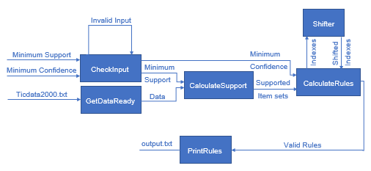
System Architecture
The following diagram describes the whole system architecture

Slide 8
Development Environment
The Apriori algorithm was implemented using R, which is a free software environment for statistical computing and graphics.
The project was completely developed and debugged by using RStudio integrated development environment for R language.
It is important to mention that NO ready libraries to calculate either the support, confidence, lift, leverage, or association rules were used, as requested in the project requirements

Slide 9
Activities Table
Activity | Predecessor | Duration(days)
Data extraction and input validation | - | 7
Support calculation | Data extraction and input validation | 8
Confidence, lift and leverage calculation | Support calculation | 10
Outputting the rules | Confidence, lift and leverage calculation | 7
Report, presentation slides and demo | Data extraction and input validation. Support calculation. Confidence, lift and leverage. calculation Outputting the rules. | 6

Slide 10
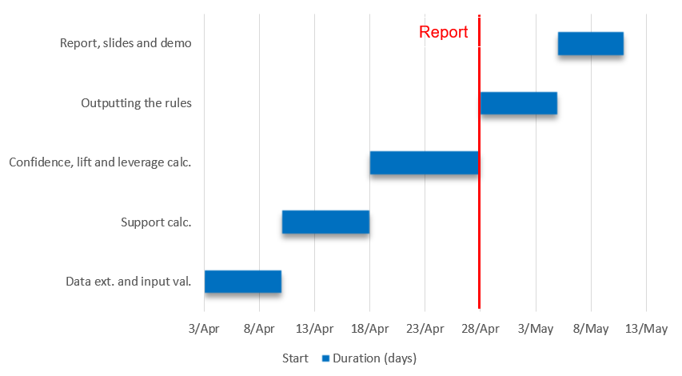
Gantt Chart

Slide 11
Earned Value Analysis
Report at week 5
Activity | Actual % complete | Incurred time (days)
Data ext. and validation | 100% | 8
Support calculation | 100% | 9
Confidence, lift and leverage calc. | 80% | 8
Outputting the rules | 0% | 0
Report, slides, and demo | 0% | 0
Activity | Actual time | Earned value | Planned value | SPI | SV
Data ext. and validation | 8 | 7 | 7
Support calculation | 9 | 8 | 8
Confidence, lift and leverage calc. | 8 | 8 | 10
Outputting the rules | 0 | 0 | 0
Report, slides, and demo | 0 | 0 | 0
Total | 25 | 23 | 25 | 0.92 | -2
SPI=Earned value/ Planned value
SV=Earned value – Planned value
SPI: schedule performance index
SV: schedule variance

Slide 12
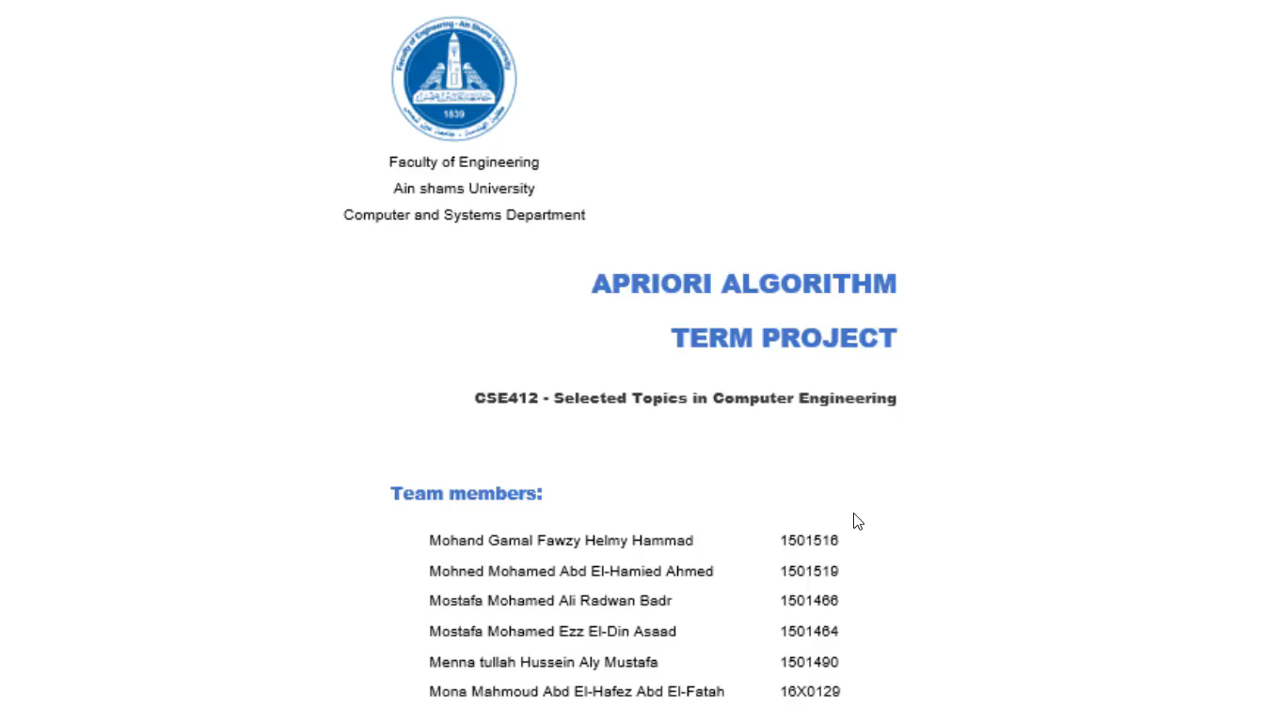
Demo Video

